Slide 1

Project Title – Healthcare Analytics for Doctor Visitors.
Student Name:
Bishal Naskar.

Slide 2

PROBLEM STATEMENT
Health-care Analytics for Doctor Visitors using the data sheet.
Data Collection & Optimization.
No. of patients visits & income analysis.
No. of patients visits to the hospital.
Doctor Performance Analysis.
No. of male, female affected by illness.
Analyse the reduced days of activity illness based on gender.
Analyse patient income & insurance.
Number of male & female affected by illness.

Slide 3
Project Description
The project aims to leverage data science techniques to enhance healthcare services by analyzing doctor visitors' data sheets. By harnessing the power of data analytics, this project seeks to optimize various aspects of healthcare delivery, including patient care, doctor performance, resource allocation, and cost management.

Slide 4

WHO ARE THE END USERS?
Healthcare Providers.
Hospital Administrators.
Healthcare analysts.
Patients.
Healthcare Executives.

Slide 5

Technology Used
Python –
NumPy
Pandas
Matplotlib
Seaborn

Slide 6
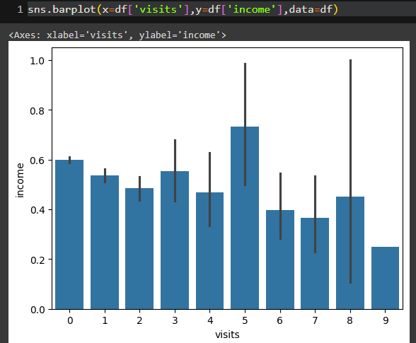
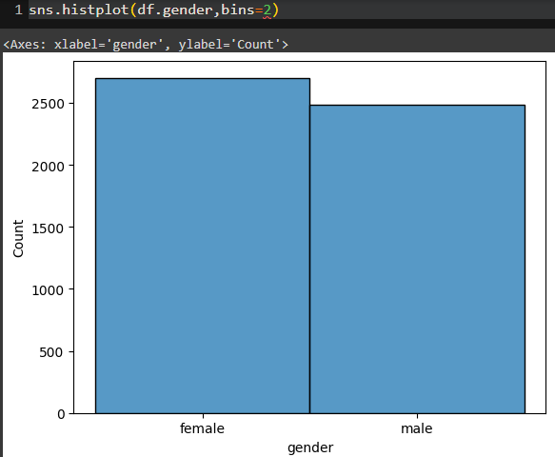
RESULTS

Slide 7
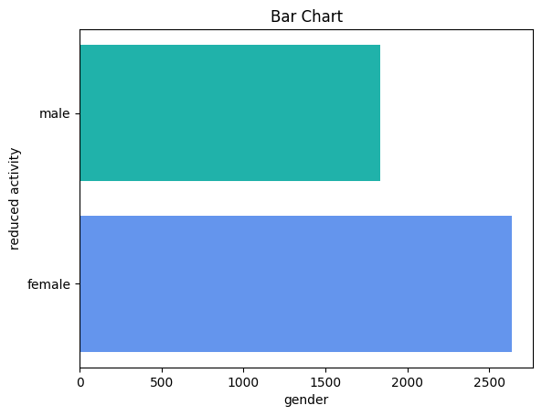
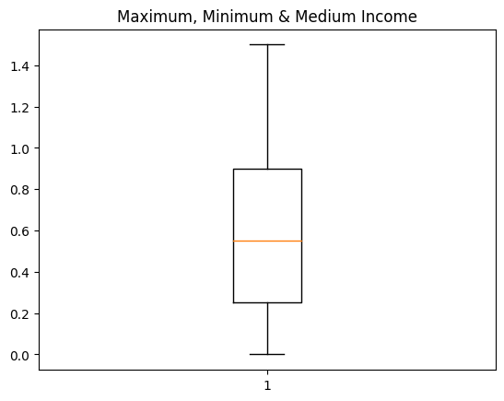
RESULTS

Slide 8
Thank you
In this project session I am learned:
Python tools for analysing the data.
How to deal with the data sheet for analysis.
How to analyze the data set with visualization.
.
.

